Slide 1
INTEL PRODUCTS SENTIMENT ANALYSIS FROM ONLINE REVIEWS
Name: Nidhi G
USN: 1BI21 CS082
Department of Computer Science and Engineering
Bangalore Institute of Technology
K.R. Road, V.V.Puram, Bangalore-560 004

Slide 2
Problem Statement
Intel Products are reviewed by end users and tech reviewers on various platforms. Hence, the ask here is to scrap the reviews available on different sources in the last 3 - 5 years.
Applying various exploratory data analysis, machine learning and natural programming techniques to find the sentiments of products, clustering of affinity reviews, trends of sentiments over period of time, features and key words extraction to specific sentiments, recommendation on key improvements based on users reviews for future products.
Ensuring sentiments and any other analysis is also demonstrated on different product category.

Slide 3
Collection of Data
In this project, Playwright library of python is utilized to extract data from Amazon. Specifically, leveraging the “async_playwright” module, which integrates with “asyncio” for asynchronous web scraping.
Features of data:
Product name - “ Intel Core I9-14900K LGA 1700 New Gaming Desktop Processor 24 Cores (8 P-Cores + 16 E-Cores) with Integrated Graphics – Unlocked “
Rate – “ 5.0 out of 5 stars ”
Review Date –“ Reviewed in India on 20 November 2023”
Review Text – ”Fast shipping. Works as advertised. ”
Patter Name- “Pattern Name: ProcessorStyle Name: Core™ i9-14900k ”
Product MRP – “ ₹82,350”

Slide 4
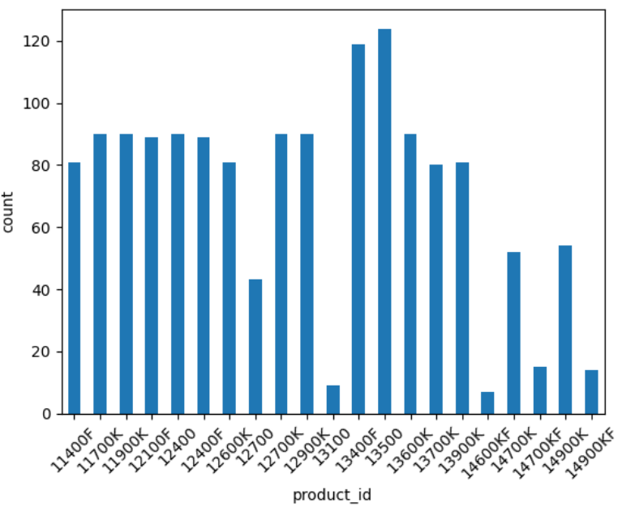
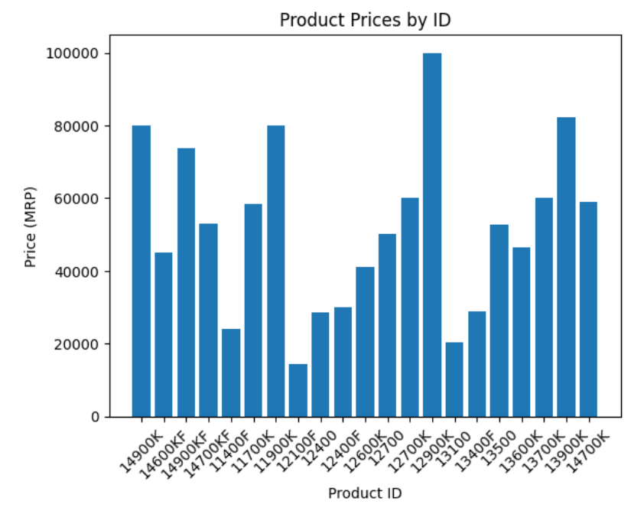
Analysis of the Data
Number of reviews for each product
MRP of different Products

Slide 5
Sentiment Analysis Approach
For sentiment analysis and classification in this project, the VADER model, a rule-based approach using a lexicon of words with sentiment scores, and the RoBERTa model, a deep learning approach based on the Transformer architecture fine-tuned for sentiment tasks, have been used.
VADER provides quick, lexicon-based sentiment analysis, while RoBERTa leverages contextual representations from extensive text data for more nuanced insights.

Slide 6
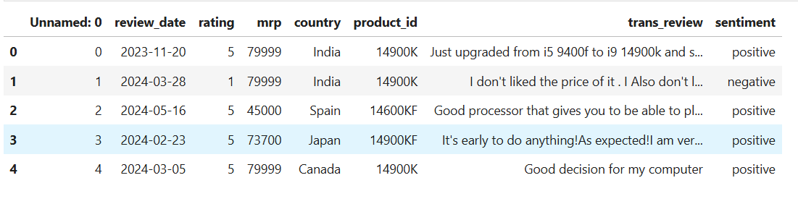
Results after classification using the models
The following shows a part of classified reviews

Slide 7
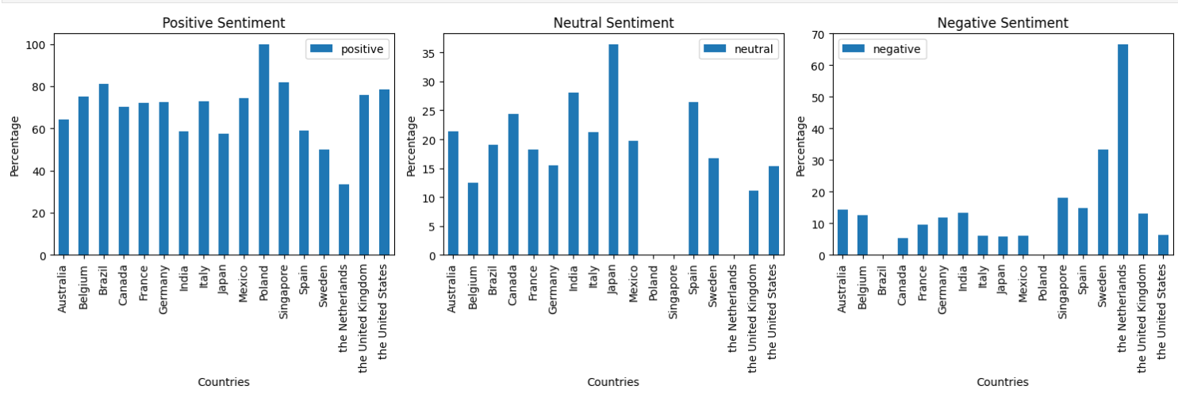
Conclusions based on classification
Comparing reviews from different countries

Slide 8
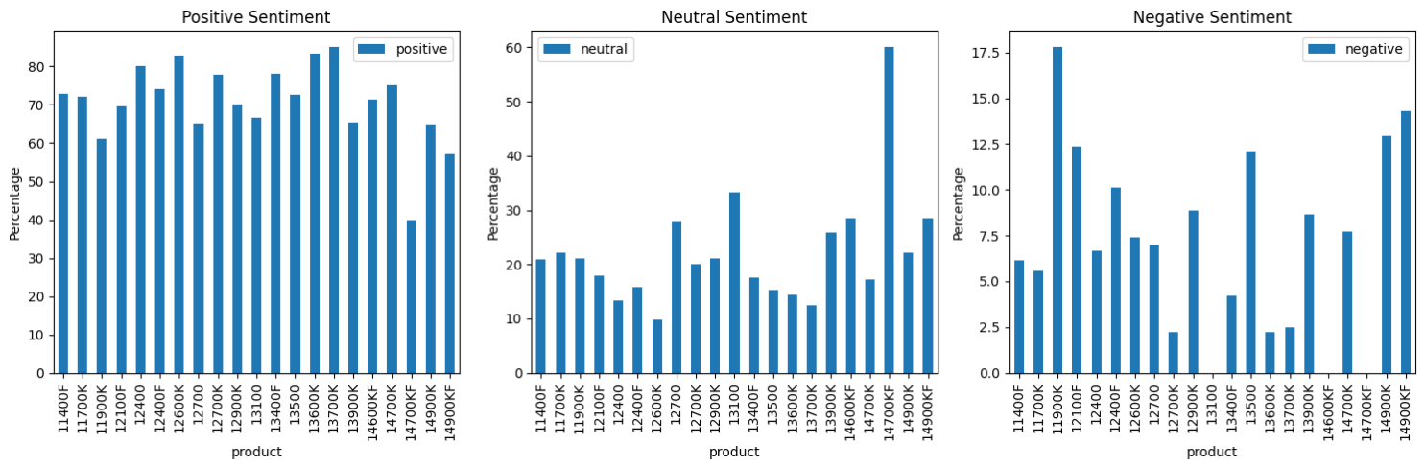
Review of each product vs their sentiment

Slide 9
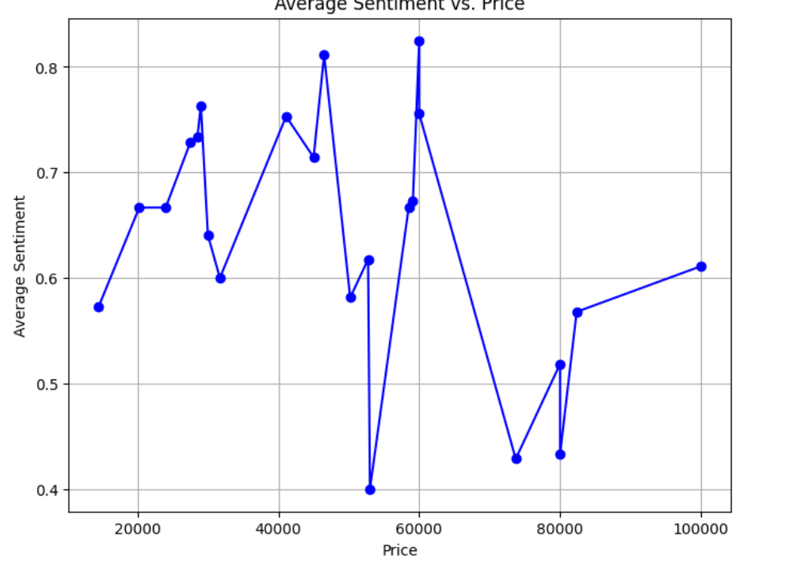
Sentiment of the product and price of the product

Slide 10
Thank you

